Slide 1
Underwater Fish Species Recognition using Deep Learning Techniques
NAME:SAI VARDHAN REDDY KONYALA
Student id:700745733
Video link: https://drive.google.com/file/d/1EPKpPYam7TE4fwZ0KafdfJm74LMGeP7W/view?usp=sharing
Github link:https://github.com/vardhan141/deeplearningjournal

Slide 2
Motivation
Fish species serve as indicators of the health and condition of aquatic ecosystems. Monitoring fish populations through deep learning techniques can provide valuable insights into environmental changes, pollution levels, and overall ecosystem health.
Deep learning techniques allow for non-intrusive data collection. By analyzing images or videos captured by underwater cameras, researchers can avoid disturbing marine life and obtain valuable data without direct contact.
Recent advancements in deep learning, particularly in computer vision, have led to highly accurate image recognition models. These advances make it an opportune time to apply these techniques to underwater fish species recognition.
Underwater fish species recognition using deep learning techniques combines expertise from fields such as marine biology, computer vision, and artificial intelligence, fostering interdisciplinary collaborations and driving innovation.

Slide 3
Problem statement
Because of the complex background and noise in the photos, recognizing fish species in the natural habitat is a difficult challenge. Many researchers have worked on this topic in the past. Numerous approaches have been proposed throughout the last decade to categorize fish species in their native habitat.
Here we are using Both Deep learning model (CNN) and Machine learning models such as SVM,KNN for recognition of underwater fish species by using Fish4Knowledge dataset

Slide 4
Objectives
The project's primary objectives include reducing the complexity of the dataset by using of combination of deep learning and machine learning, with deep learning used to extract key features and machine learning is used for classification.
fish4knowledge dataset for fish classification, including 23 categories and 20,000+ pictures which has enough images for deep learning to learn the features.
To process this dataset, the project is using the combination of deep learning and machine learning we are using deep CNN (Convolutional Neural Networks) with SVM,KNN for classification for better accuracy.

Slide 5
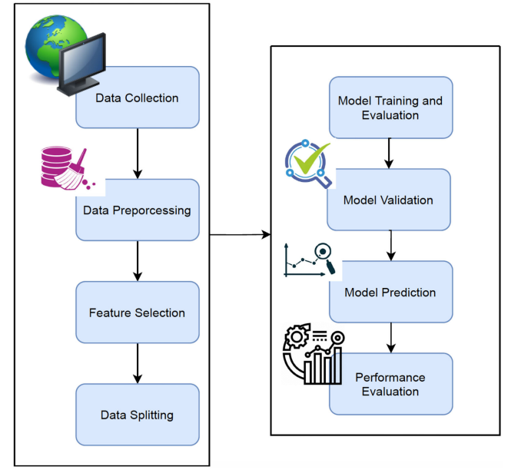
Contributions
Compared to the existing frameworks the project uses deepcnn-knn for the best accuracy. One of the main reasons for this is the proposed framework uses One of the key reasons for this is that we employed max-pooling after each convolution layer in our recommended frameworks. Max-pooling is capable of detecting the existence of edges, which is essential in our fish Identification of species. As a result, following each convolution layer, The image's boundaries are retained and handed on to the following layer. This aids in the preservation of all critical elements in the phase of feature extraction.
Proposed workflow:

Slide 6
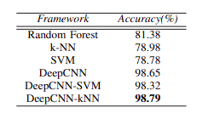
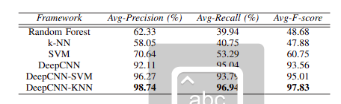
Results
Here using both machine learning for feature extraction and deep learning for classification is very useful for getting the maximum accuracy.
To measure the performance we are using the using the accuracy,precision,recall,F-score.
After getting the results deepcnn-knn performed the best when compared to other models as Shown below

Slide 7
References
[1] Heithaus, M. R. and Dill, L. M., “Food availability and tiger shark predation risk influence bottle nose dolphin habitat use,” in Ecology, vol. 83(2), 2002, pp. 480–491.
[2] Rova, A., Mori, G., and Dill, L., “One fish, two fish, butterfish, trumpeter:recognizing fish in underwater video,” in IAPR Conference on Machine Vision Applications, 2007, pp. 404–407. WK,QWHUQDWLRQDO&RQIHUHQFHRQ6LJQDO3URFHVVLQJDQG,QWHJUDWHG1HWZRUNV 63,1 668
[3] Shafait, F., Mian, A., Shortis, M., Ghanem, B., Phil Culverhouse, F., Edgington, D., Cline, D., Ravanbakhsh, M., Seager, J., and Harvey, E., “Fish identification from videos captured in uncontrolled underwater environments,” ICES Journal of Marine Science, vol. 73(10), pp. 2737– 2746, 2016.
[4] Strachan, N. J. C., “Recognition of fish species by colour and shape,” Image and Vision Computing, vol. 11, pp. 2–10, 1993.

Slide 8
[5]Strachan, N. J. C. and Kell, L., “A potential method for the differentiation between haddock fish stocks by computer vision using canonical discriminant analysis,” ICES Journal of Marine Science, vol. 52, pp. 145–149, 1995.
[6] White, C. and Strachan, N. J. C., “Automated measurement of species and length of fish by computer vision,” Fisheries Research, vol. 80, pp. 203–210, 2006.
[7] Storbeck, F. and Daan, B., “Fish species recognition using computer vision and a neural network,” Fisheries Research, vol. 51, pp. 11–15, 2001.
[8] Nery, M., Machado, M., Padua, F., Carceroni, R., and Queiroz-Neto, J., “Determining the appropriate feature set for fish classification tasks,” in Proceeding of the XVIII Brazilian Symposium on Computer Graphics and Image Processing, 2005.
[9] Chuang, M., Hwang, J. N., and Rose, C., “Aggregated segmentation of fish from conveyor belt videos,” in IEEE International Conference on Acoustics, Speech and Signal Processing (ICASSP), 2013, pp. 1807– 1811.

